Slide 1
Agenda Item 23: Title: Donor and Partner Meeting Update
Presenter: Salesa

Slide 2
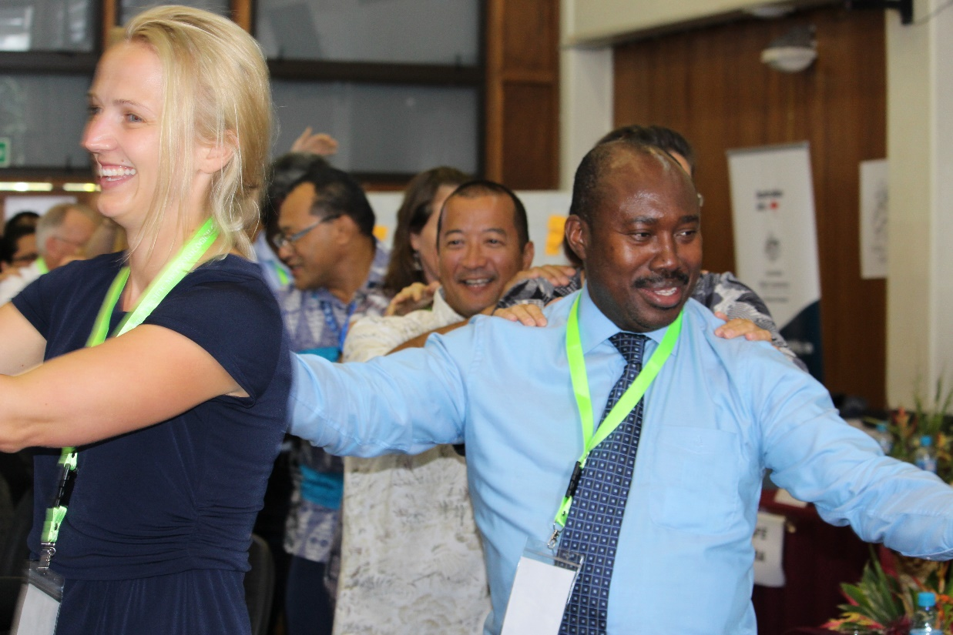
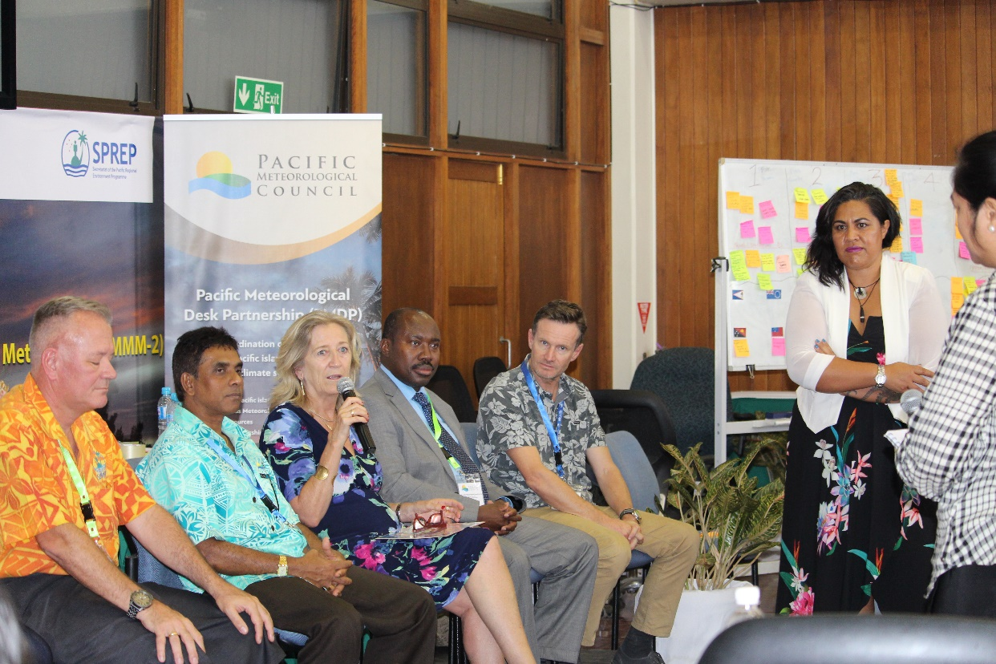
Background
1. First Roundtable meeting held in Honiara, 2017
Provide an opportunity for NMHSs, donors and partners to discuss programs and their support for the continued development of weather and climate resilient of Pacific communities.
Forum for discussion on sustainable weather, climate, hydrology, and ocean services, in the context of the PIMS, and the PRSCS and resources mobilization during the PMC and the donors and partners roundtable meeting
2. Second Tanoa Session with Partners and Countries, 2019
updating of the Project Mapping
Overview of the existing coordination mechanisms at SPREP to implement the PIMS

Slide 3
Session 1: Welcoming Formalities
9.00-9.30 | Prayer - TBD Welcome Remarks – Mr. Sefanaia Nawadra, SPREP Director General Opening Remarks – Prof. Petteri Taalas, WMO Secretary General Meeting Objectives – Ms. Tagaloa Cooper-Halo | Moderator – Ms. Tagaloa Cooper-Halo
Session 2: Sustainable Regional Coordination
9.30.10.00 | Overview of the Pacific Island Meteorological Strategy (PIMS) and other regional strategies and frameworks PMC governance Links to COP28 Outcomes/Support from related initiatives | Moderator – Ben Churchill Presenter – Tagaloa Cooper-Halo Salesa Nihmei
10.00-10.30 | Photo and Morning Tea
Session 3: Strengthened Collaboration and Coordination
10.30-11.00 | Presentation of the PPCM Framework of engagement of the PMC Partners Coordination Mechanism Open dialogue and feedback from donors/partners | Moderator: Chaponda Moyenda Presenter: Salesa Nihmei
11.00-11.30 | Pacific Region Project and Programme Data Analysis Report Launch of the Dashboard – President RA-V and PMC Chair | Presenter -Chaponda Moyenda

Slide 4
Session 4: Inclusive Programmes
11.30- 12.30 | Weather Ready Pacific Programme Overview, Progress and Governance Structure Dialogue Session with Development Partners | Presenters Tagaloa Cooper-Halo Ofa Faanunu Patricia (Consultant)
12.30-1.30 | Lunch Break
1.30- 2.00 | Early Warning for All Initiative Overview and rollout Process Questions and Answer session | Moderator – Ms. Tagaloa Cooper-Halo Presenter – Cyrille Honoré
Session 5: Projects|Programmes and Donor Priorities
2.00-4.00 | Breakout Session – Cafe Style in Thematic Areas ‘Statements on current and future opportunities for projects and programmes by donors to support the Weather Ready Pacific Programme and PMC priorities’. Group Reporting session | Moderator: Salome Tukuafu
Grab a Coffee
4.00-4.30 | Feedback session Key Outcomes of the Meeting Official Closing | Moderator: Salesa Nihmei

Slide 5
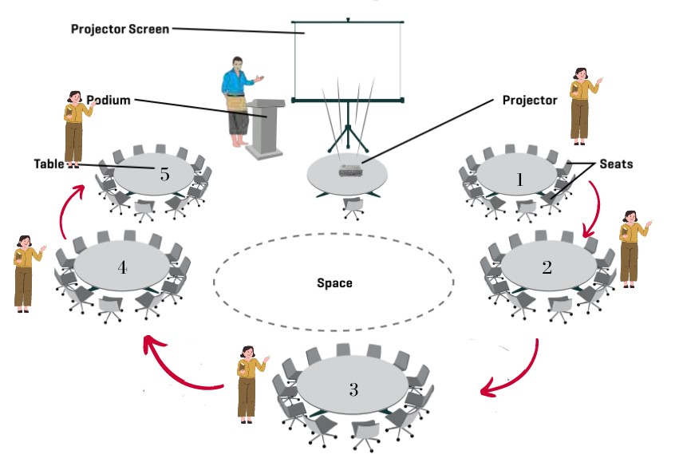
Setup for Thursday Session 4- All Partners
 | CAFE STATION NAMES
1 | Aviation Weather Services
2 | Climate and Ocean Services
3 | Hydrology and Water Resources
4 | Communications and Infrastructure
Cross cutting through the Cafe stations will be EWS, capacity building (education and training) and gender/social inclusion

Slide 6
Pacific Partners Coordination Mechanism (PPCM)
Aims to enhance collaboration for hydrometeorological projects in the Pacific Islands region.
Addresses challenges of coordination and resource allocation.
Aligns with PMC and Weather Ready Pacific.

Slide 7
PPCM
Systematic exchange of program/project information for enhanced collaboration.
Platform for donors to align resources, support Weather Ready Pacific and national initiatives.
Harmonize and improve interventions at national and regional levels.
Facilitate alignment of donor objectives with regional priorities for maximum impact.

Slide 8
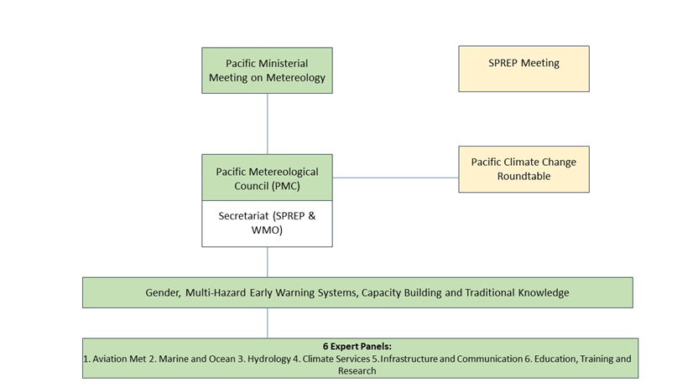
Approach
Utilizes annual meetings, special program sessions, ad-hoc discussions, and a data analysis dashboard.
PMC-6 meeting to establish a foundation for continuous engagement and information sharing.
Expected outcomes: Enhanced coordination, alignment of resources, improved interventions.

Slide 9
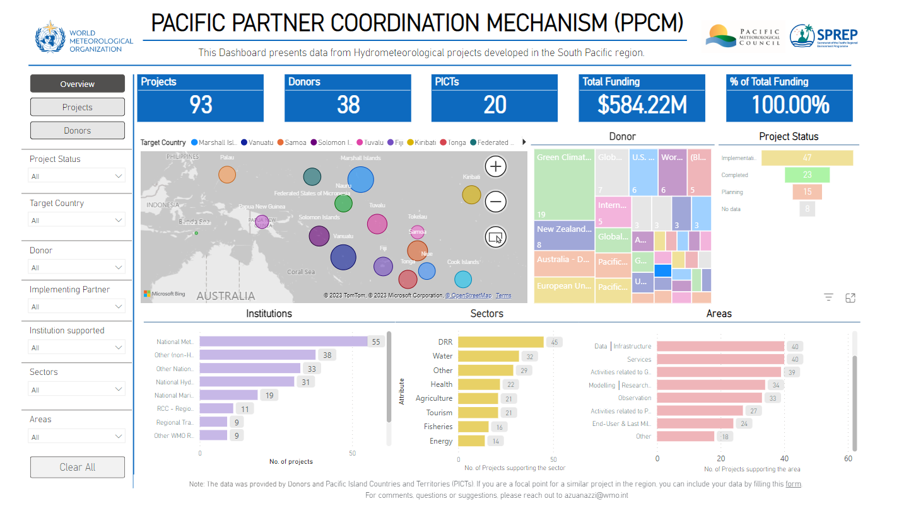
Notes:
Microsoft Power BI link for dashboard

Slide 10
Recommendations: [Key decisions for the PMC to deliberate and endorse]
The Meeting is invited to:
Note the arrangements for the Donor and engagement

